Slide 1
Water Resource

Slide 2
We already know that water covers about three-quarters of the Earth’s surface, and
It is essential to life (plants, animals, humans)
Water is a renewable resource- that is after it has been used it returns to the water cycle and in time it will be used again.
The total abundance of water on Earth might not seem to be a problem.
people rely heavily on fresh water and its amount is limited ( 3.5%) in comparison to the rising world population and increasing demand.
Huge amount of water is being polluted and also wasted.
Making water available where and when it is needed is a problem.

Slide 3
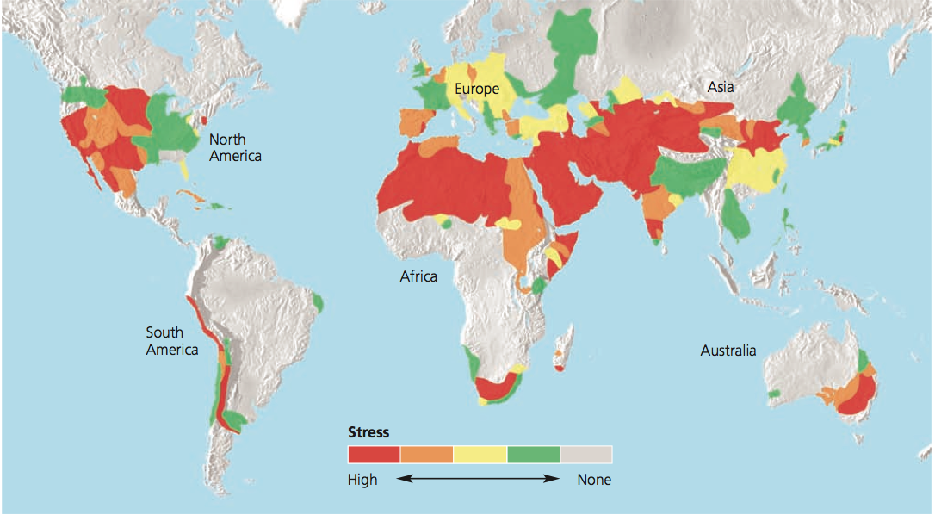

Slide 4
Use of Water
Water is used in many different ways, including:
Domestic use: for showering, washing clothes, watering lawns and gardens etc.
Agricultural use: includes water used in irrigation.
Industrial use: water used for processing, washing and cooling in facilities that manufacture products.
In-stream uses: hydroelectric power generation, navigation, recreation, fish and wildlife habitats (ecosystems).
Worldwide,
irrigation agriculture consumes over 70% of all the water used by people
industry accounts for a further 20 % and
domestic & municipal uses account for most of the remainder (10%).
The amount used, and what it is used for, varies a great deal from country to country.

Slide 5
Increasing Demand For Water (Fresh Water)
Water is the most basic and most important of all natural resources.
We require regular supplies of water but it must be fresh water.
Most comes from rivers, lakes and underground aquifers.
Sea water can be used but the salts dissolved in it must first be removed (by desalination) before it is suitable for people to drink or use directly.
Demand for water has increased markedly in recent centuries.
During the twentieth century world water use increased seven times.

Slide 6
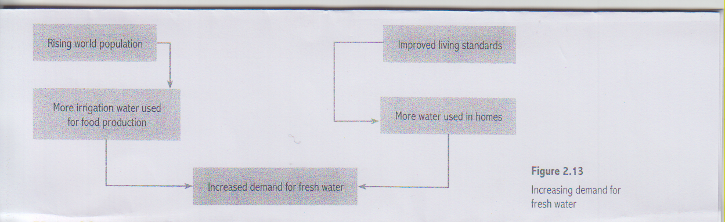

Slide 7
Water conservation
Water conservation is the careful use and the protection of water resources. It involves both the quantity of water used and its quality. Conservation is an important component of sustainable water use.
Steps that can be followed for water conservation:
Use improved agricultural irrigation system
Use computer monitoring and schedule release of water for maximum efficiency
Integrate the use of surface water and ground water to more effectively use the total resources
Turn off water when absolutely not needed for washing, brushing and so on
Take a long bath rather than a long shower
Don’t wash sidewalks and driveways with water rather sweep them
Industries might curb water usage by increasing in-plant treatment and recycling of water or by developing new equipment and processes that require less water.

Slide 8
Sustainable water use
Water is essential for life. It is also necessary for maintaining ecological systems necessary for the survival of humans. As a result water plays important roles in
ecosystem support
economic development
community well-being
From water supply use and management perspective, sustainable water use can be defined as use of water resources by people in a way that allows society to develop and flourish into an indefinite future without degrading the various components of the hydrologic cycle or ecological systems that depend on it.

Slide 9
THANK YOU

